Slide 1
Foundational Principles for Flourishing Nations
Global Forum 2022

Slide 2
What is a Principle?
A fundamental truth that serves as the foundation for a system of belief.

Slide 3
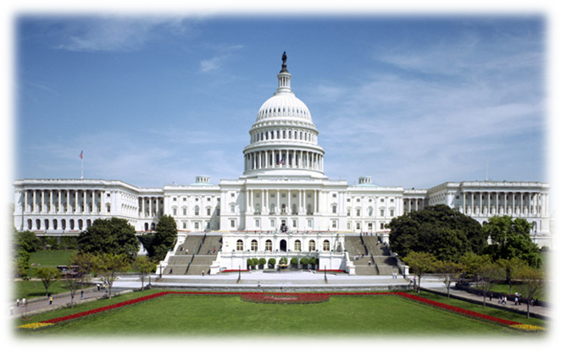
Paradigm (Worldview)
Principles
Policies
Programs & Practices
Notes:
Our cultures and societies are all established upon a deep belief-system. A worldview. A paradigm. This gives rise to foundational principles, which in turn shape policies, laws, and educational curriculum, which drive programs and practices in business, government, education, entertainment, and everywhere else.
If it is not the biblical worldview and biblical first principles, it will be another worldview and other first principles.
What do I mean by biblical first principles? I mean things like this:
God’s moral law is “the law over all” and all people, including the most powerful are under it, and accountable to it. This is the foundation for the rule of law, not the rule of man. The foundation for genuine justice.
All people are made in God’s image and likeness, with God-given dignity and worth. Human life is sacred. This is true of all people, regardless of skin color, ethnicity, sex, or wealth.
All people have God-given rights to life and to freedom. Nobody is born to be a slave to another. Nobody has the right to kill or murder another. These rights must be respected by everyone, particularly the most powerful.
God created man male and female.
He created marriage to be the union of a male and female as husband and wife, and to be the place where children are properly raised and nurtured. Sex is reserved for marriage alone. Marriage is the most basic God-given institution in society, and strong marriages and families are essential to the health of the society.
These principles, and many more, should shape every area of culture. Politics, business, education, government, the arts. Etc.
QUESTION: Are these principles shaping our nation? Are they shaping our laws, policies, educational curriculum? If not, what first principles are? What worldview are they rooted in?

Slide 4
John Amos Comenius
Foundational Principles
All human life is sacred, with God-given dignity, purpose, and worth.
Humans are to wisely rule over creation.
A “Secondary Principle” Applied to Education
“Everyone should be taught everything.”

Slide 5
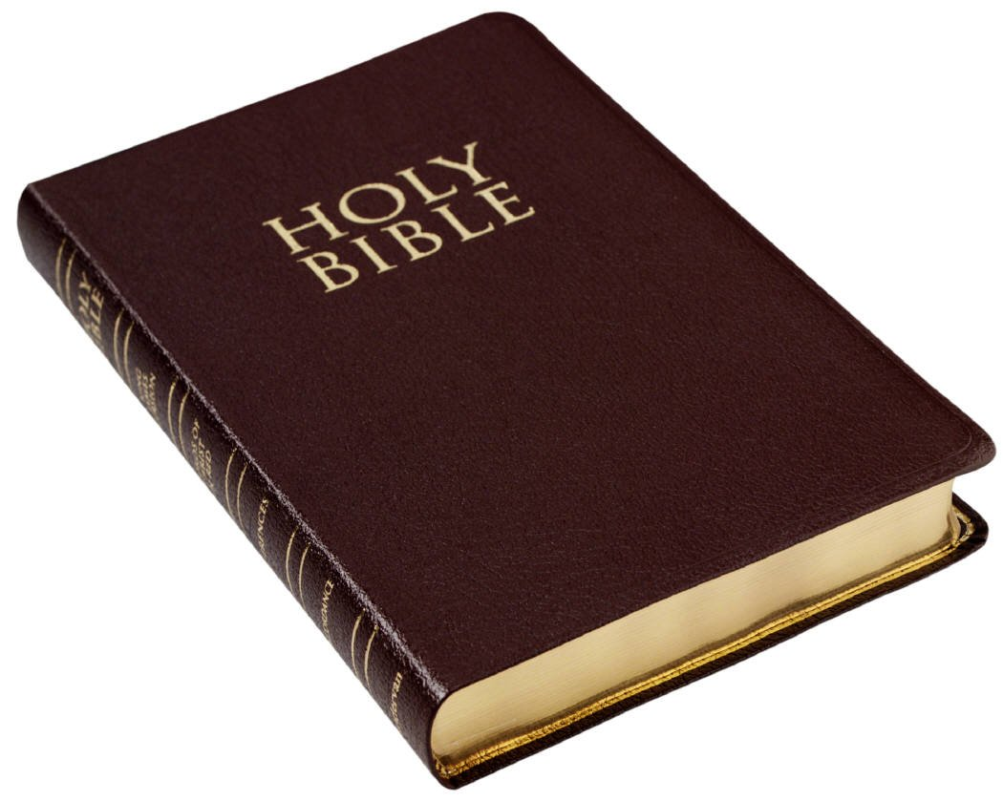
Sacred-Secular Dualism
Heaven
Church
Theology
Personal piety
Missions
Devotional Life
Salvation
Higher
more important
Sunday
The Bible Applies
SACRED
(spiritual)
Earth
Justice
Science
Business/economics
Politics
Art/entertainment
Education
Lower
less important
The Bible Doesn’t Apply
SECULAR
(cultural)
Weekdays
Notes:
The Bible only applies to the sacred realm, and topics like church, salvation, and personal holiness, but it doesn’t apply to anything else.
Jesus is King over the sacred realm, but not the secular realm. It is fallen, worldly, and the domain of Satan.
It is quasi-biblical worldview—a syncretistic worldview that embraces biblical truth for some things, while adopting prevailing cultural assumptions for everything else.
Who defines the principles that shape the secular realm? Non-Christians. People promoting atheistic worldviews, like Marxism and ISJ.
Tragically, this profoundly impacted the church in carrying out her mission. It has prevented her from being salt and light in a dying world.
They are Christians on Sunday, but conform to the dominant culture and its postmodern belief-system on Monday.

Slide 6
Paradigm (Worldview)
Principles
Policies
Programs & Practices
Notes:
Our cultures and societies are all established upon a deep belief-system. A worldview. A paradigm. This gives rise to foundational principles, which in turn shape policies, laws, and educational curriculum, which drive programs and practices in business, government, education, entertainment, and everywhere else.
If it is not the biblical worldview and biblical first principles, it will be another worldview and other first principles.
What do I mean by biblical first principles? I mean things like this:
God’s moral law is “the law over all” and all people, including the most powerful are under it, and accountable to it. This is the foundation for the rule of law, not the rule of man. The foundation for genuine justice.
All people are made in God’s image and likeness, with God-given dignity and worth. Human life is sacred. This is true of all people, regardless of skin color, ethnicity, sex, or wealth.
All people have God-given rights to life and to freedom. Nobody is born to be a slave to another. Nobody has the right to kill or murder another. These rights must be respected by everyone, particularly the most powerful.
God created man male and female.
He created marriage to be the union of a male and female as husband and wife, and to be the place where children are properly raised and nurtured. Sex is reserved for marriage alone. Marriage is the most basic God-given institution in society, and strong marriages and families are essential to the health of the society.
These principles, and many more, should shape every area of culture. Politics, business, education, government, the arts. Etc.
QUESTION: Are these principles shaping our nation? Are they shaping our laws, policies, educational curriculum? If not, what first principles are? What worldview are they rooted in?

Slide 7
Notes:
They had a motto that described their basic worldview. Coram Deo. God is Lord over all. We live in all areas of life “before His face” and “for His glory.”
Now you could be a politician or a businessman and still honor and glorify God, because you were doing your work “before the face of God,” and for His glory.
And His Word wasn’t simply reserved for spiritual matters, but it was a handbook for every area of life!
This changed the way musicians wrote their music. Think of Bach. Soli Deo Gloria. No wonder he wrote some of the most beautiful music ever composed.
It impacted architecture. It impacted farming. The farms of northern Europe today continue to be some the most beautiful and productive in the world.
In impacted the entire culture, and lifted the nations of northern Europe out of poverty, and the ripples are being felt even to this day.
The principles of the Bible apply to every area of life, and are to shape every area of life.

Slide 8
Public Truth
“We must affirm the gospel not only as an invitation to a private and personal decision but as public truth which ought to be acknowledged as true for the whole of the life of society.”
- Lesslie Newbigin
Notes:
The sacred-secular mindset sees Christian faith as personal and private, but not public.
Yes, it is personal, but NOT private. It is true for everyone! For all areas of life.
“We must affirm the gospel not only as an invitation to a private and personal decision but as public truth which ought to be acknowledged as true for the whole of the life of society.”
- Lesslie Newbigin

Slide 9
Discipling Nations
The process of “weeding out” false foundational principles…
and sowing true ones in every area of society.

Slide 10
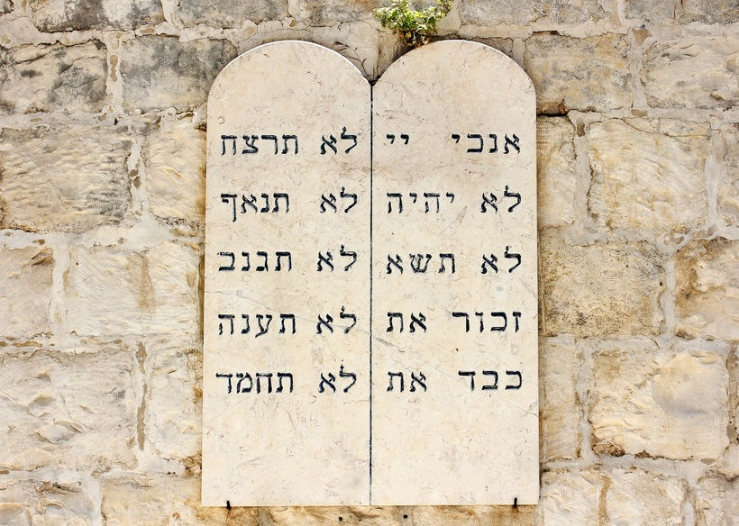
There is a law that transcends man-made laws. One that defines good and evil for all peoples, for all time. God’s moral law.

Slide 11
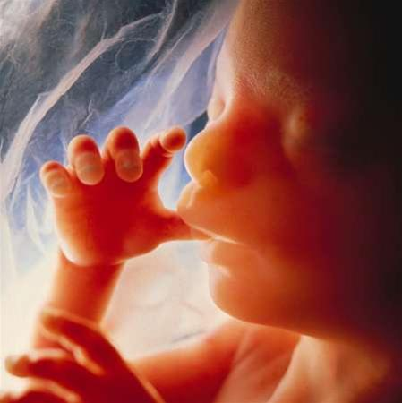
All human life is created by God, and is therefore sacred, with God-given dignity, purpose, and worth.

Slide 12
Humans are to rule over, and wisely steward creation.

Slide 13
Human creativity is the source of resources and wealth

Slide 14
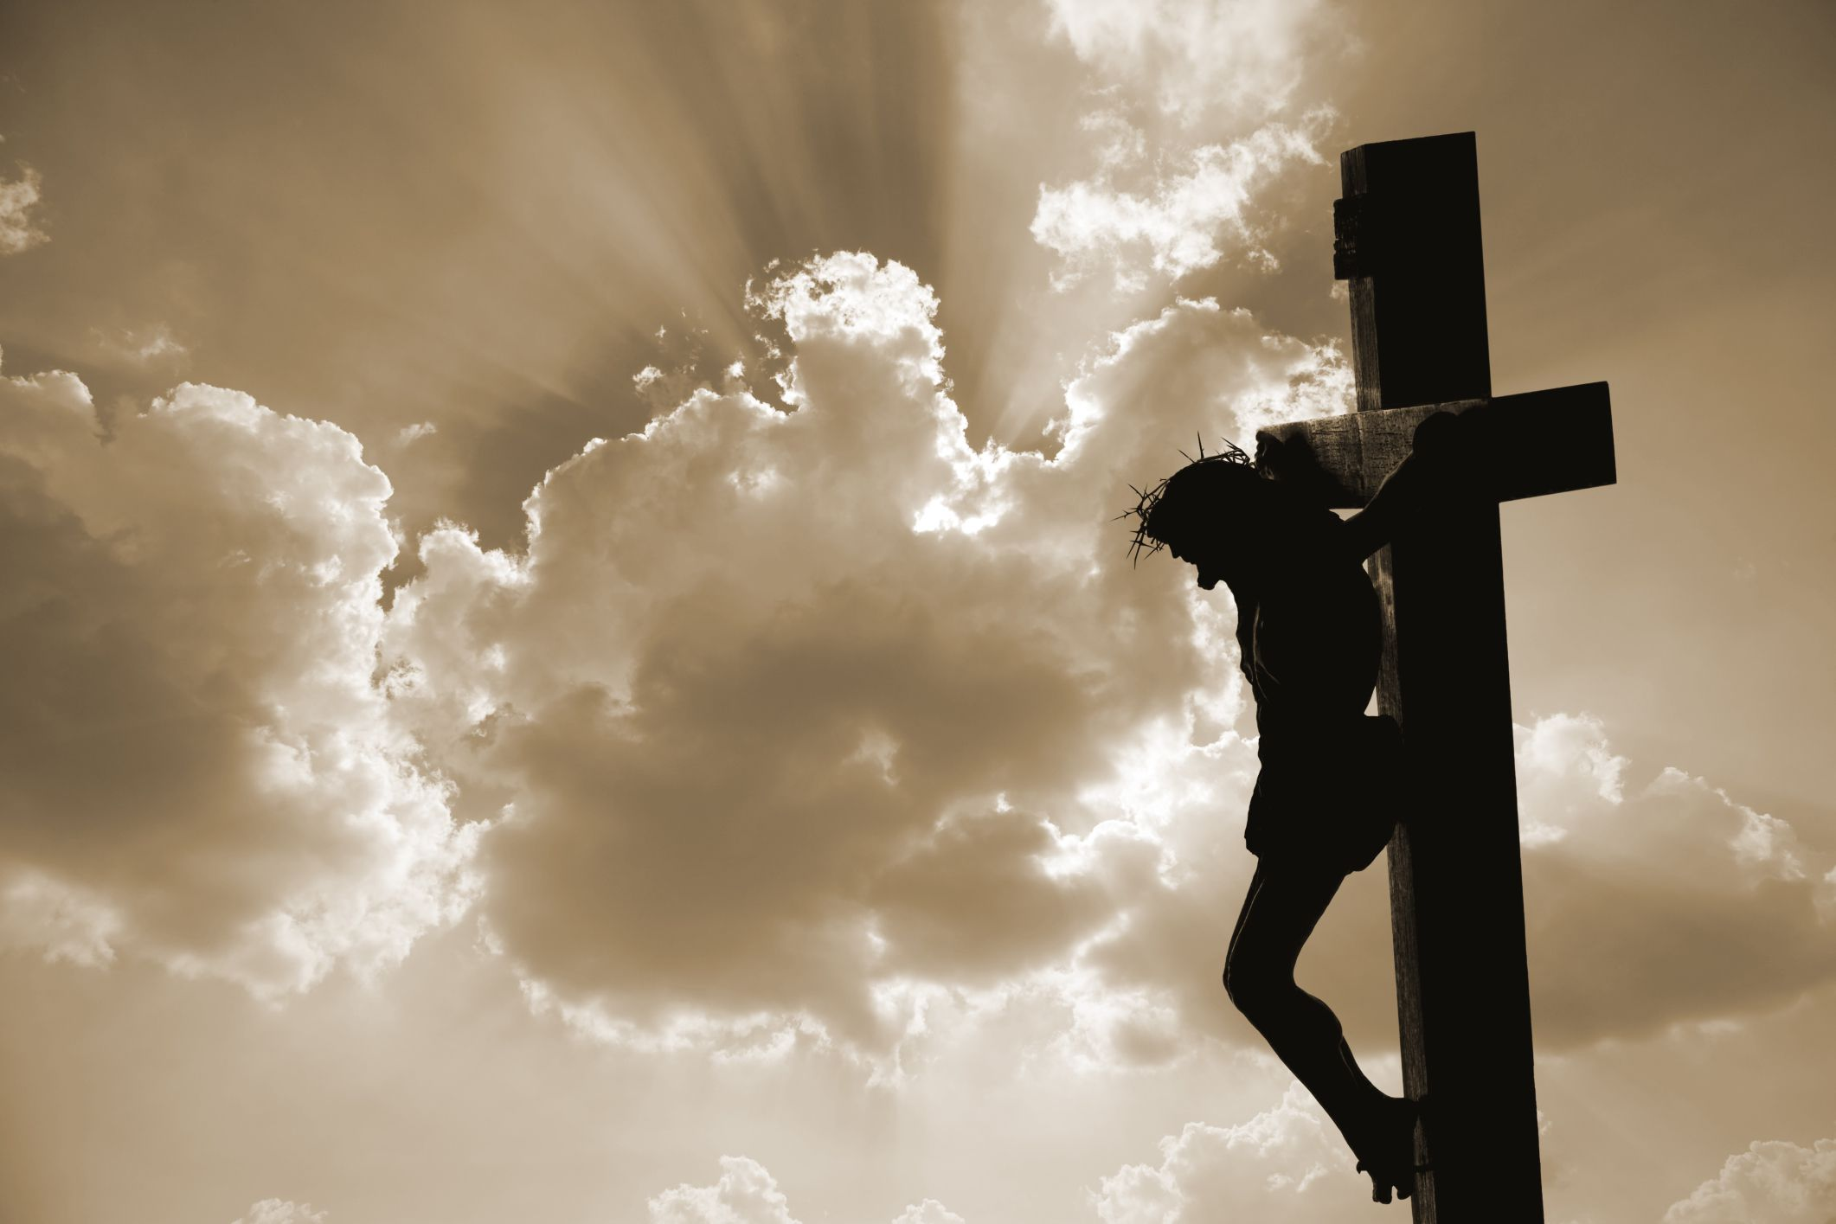
Because the source of evil, brokenness, and suffering in the world is inside of us, in our sinful hearts.
Therefore, social and cultural transformation begins with inward transformation through the Gospel.

Slide 15
God works in history to fulfill His redemptive purpose, and grants us the privilege of participating in fulfilling His purposes in the world.

Slide 16
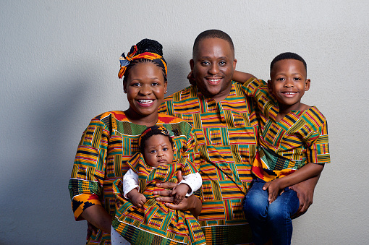
Marriage and family are the basic building blocks of strong, healthy communities and nations.

Slide 17
God and His creation affirm both unity and diversity.

Slide 18
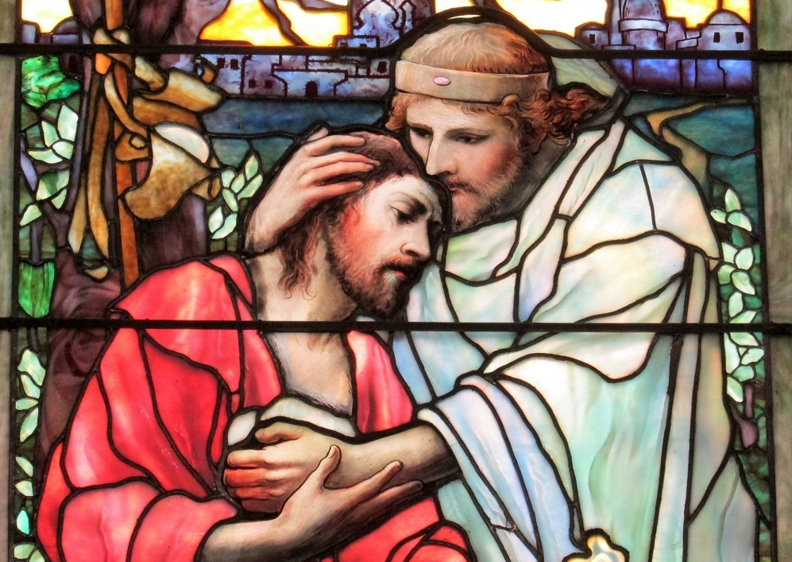
Love your neighbor. This is our highest moral duty.

Slide 19
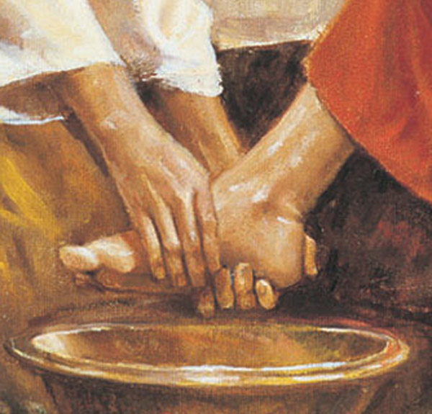
Authority is God-granted, and to be used to serve those under authority for their own good.

Slide 20
