Slide 1
Welcome to 2023 DNA Forum Adulala Resort
Ethiopia, Oromyia region
Debre Zeit/Bishoftu town,
Oct 17-20/22

Slide 2
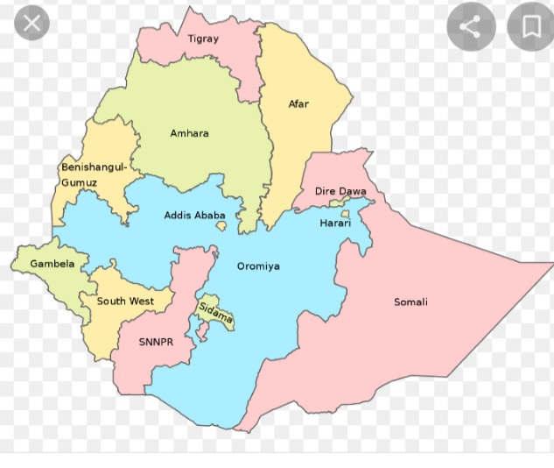
Map of Ethiopia

Slide 3
Ethiopia
An Oldest Nation that mentioned in the Bible over 40 (in the authorized Bible 60) times beginning from Genesis.
Gen. 2:13, Nile, Numb 12:1 Moses wife, Psa68:31,Jerm 13:23, Acts 8:27 Ethiopian Eunuch
Religion: 44% Orthodox, 34% Muslim, 22 Evangelical
Ethiopian Orthodox, the major religion in the nation (Where the OT & NT Traditions practiced (Church building architecture, Ark, Circumcision, fasting )
The 1st hosting nation of the follower of Prophet Mohammed (immigrated)
Paradoxes: Independent and uncolonized/war within, Blessed naturally but known for famine/drought. Now, began self sufficiency and will export wheat

Slide 4
Population: 120million 2nd populous nation in Africa
The median age in Ethiopia is estimated 19 years, 60% of the popn. is under the age of 25. (75% under 35yrs) young and productive age.
83% of Evangelicals are under the age of 35, more educated and productive
Over 86 Ethnic Group and 123 languages (current government is based on Ethnic Federalism) with 11 regions 2 city Administrative

Slide 5
Ethiopian
Monarch/Kings, Socialism (1974-1991) now Ethnic Federalism & Free market economy
Source of Blue Nile: That flows to Sudan then to Egypt.
Grand Ethiopian Renaissance Dam (GERD), is under construction costs $5Billion (Public funding) to generate 5,000 MW of electricity; Doubling Ethiopia’s electricity output (began generating 645MW and exporting to Sudan, Djibouti and others will follow).
Economy: Dominantly agriculture 35%, services 37%, Industry 23% and manufacturing 5%

Slide 6
A history of 3,000yrs that resisted colonization and inspired nations to Stand up for their freedom (S.Africa – Mandela, Zimbabwe)
Member of League of Nation and later founding member of the UN from Africa
Founder and HQ for African Union (AU), HQ for Economic Commission of Africa (ECA)
121 Embassies and Consulates in the capital, making Ethiopia among top World Diplomatic Centers.
Ethiopian Airlines over 75years of service in over 100 destination with a capacity of 25million passengers/yr

Slide 7
Background of DNA in Ethiopia
The first exposure for Worldview (DNA) Conference was 1998 in Kenya.
FHI/Ethiopia hosted DNA, by Darrow and Bob in 1999 (164ppl) and 2001 (2,000)
Organized in partnership with the Ethiopian Evangelical Church Fellowship (ECFE), where Pastors, Christian NGO, Ministry leaders, Seminary professors and practitioners were participated.
The training (thousands) continued among churches, Bible schools and with Christian University Students;

Slide 8
Phases of DNA activities
A. Vision Conferences: Spreading out the teaching/ the thinking
B. Training of Trainers: Raising as many trainers as possible
C. Incorporate DNA materials into Church, Bible college and ministries : Install the teaching/material into the existing and new organizations’ curriculum
D, Coaching and mentoring the New Generation: Follow up and experience sharing forum
-Churches began embracing DNA teaching and equipping & organizing their members based on their calling/profession so as to serve their community as salt and as disciples of Christ in every sphere of society. Thank God many changes is happening in this nation at this time!!
Among others, today we will see how the EvaSUE (Evangelical Students Union of Ethiopia) is using the DNA material and how it impacted their ministry and the life of University Students and their graduates.

